Slide 1

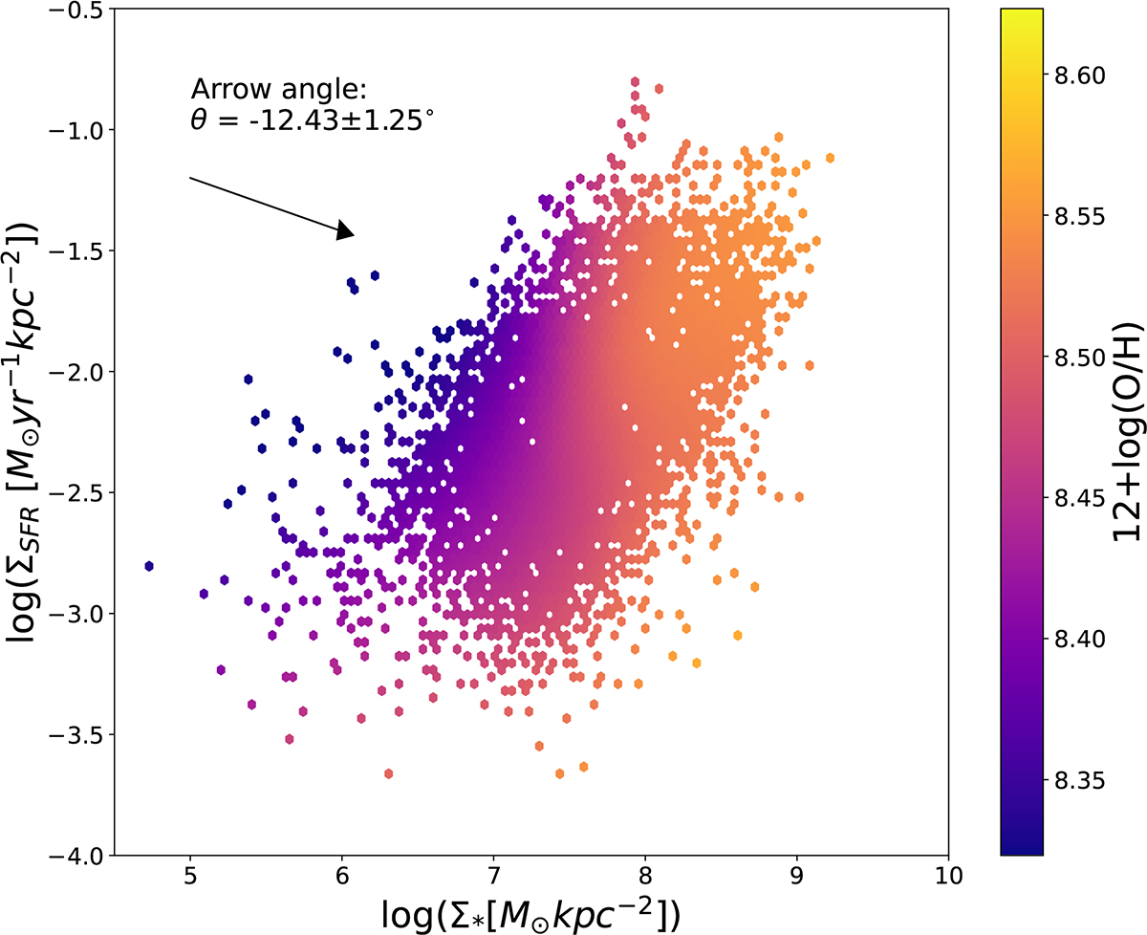

Baker+2023
Koller+2024

Slide 2
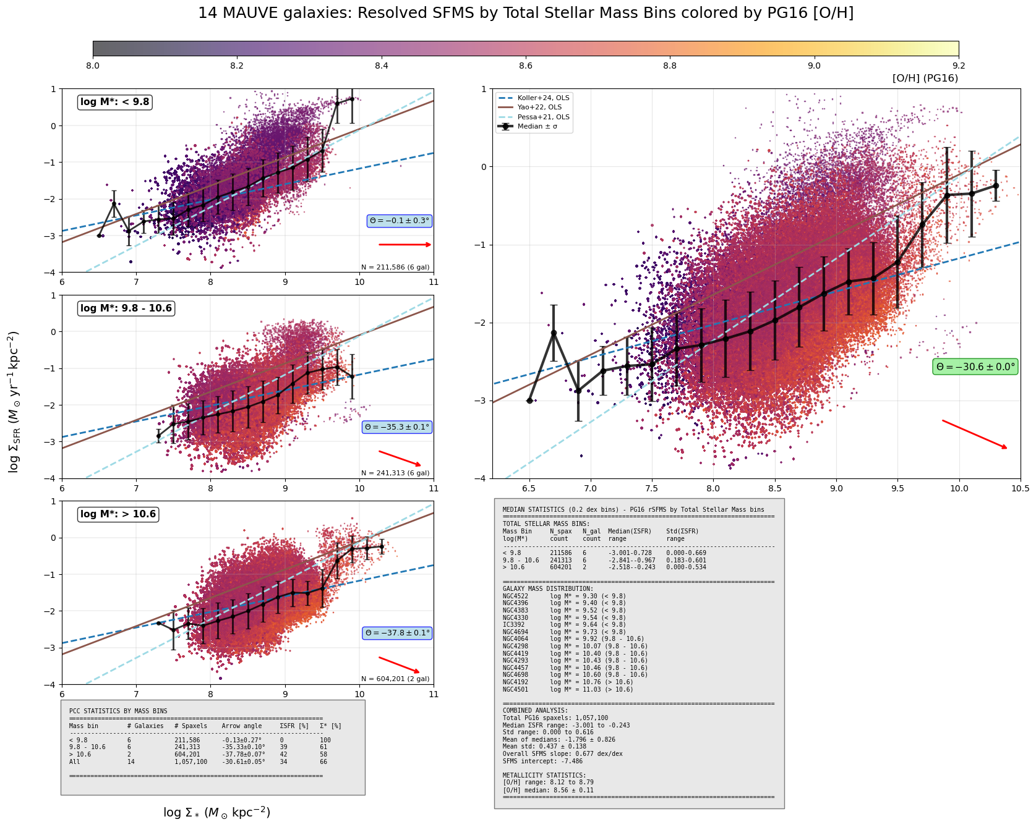

Slide 3
